Slide 1
Design of Nanoplasmonic Structure using Machine Learning
By:- Ravi Kiran Bandakavi

Slide 2
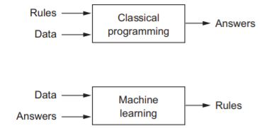
Introduction to Machine Learning
In classical programming, we input rules (a program) and data to be processed according to these rules, and out come answers. With machine learning, we input data as well as the answers expected from the data, and out come the rules. These rules can then be applied to new data to produce original answers.
A machine learning system is trained rather than explicitly programmed. It It is presented with many examples relevant to a task, and it finds statistical structure in these examples that eventually allows the system to come up with rules for automating the task.

Slide 3
Supervised Learning
Supervised learning is the machine learning task of learning a function that maps an input to an output based on example input-output pairs.
A supervised learning algorithm analyzes the training data and produces an inferred function, which can be used for mapping new examples. An optimal scenario will allow for the algorithm to correctly determine the class labels for unseen instances.

Slide 4
Supervised Learning Algorithms
Support Vector Machines(SVMs)
Linear Regression
Logistic Regression
Naïve Bayes
Decision Trees
Random Forest
K-Nearest Neighbor
Neural Networks
Gradient Boosted Decision Trees

Slide 5
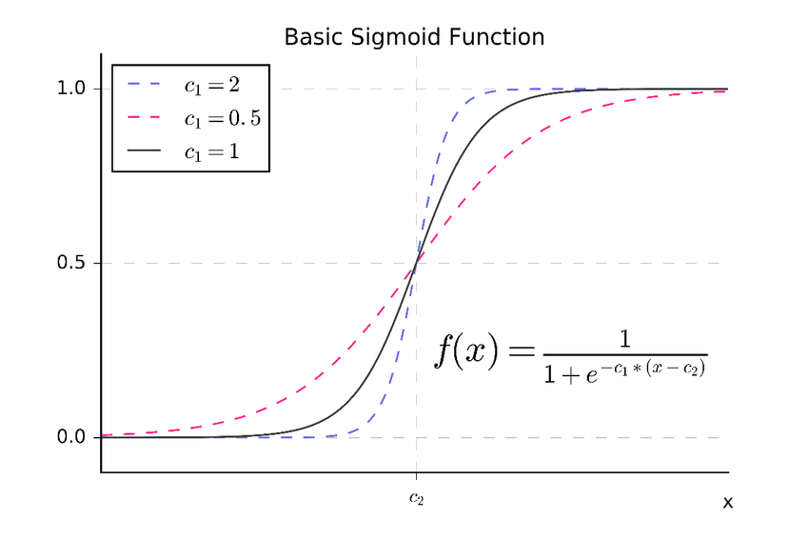
Illustration: Logistic Regression for Binary Classifier
Lets say, (x¹,y¹),(x²,y²)…….(x^{n},y^{n}) be a training data, where every x^{i} is a column vector of N features ad y^{i} is their respective label.
x^{i} = [x₁,x₂,……,x_{m}]^{T}
Parameters: w_{N}, b, C1. w_{N} is the column vector of feature weights.
Y_{i} is the predicted output for each data point.
a_{i} = Y_{i} = σ(w_{N}^{T} *x+ b).
σ(x) = (1 + exp(-C*x))⁻¹
L(a,y) = Loss function = Σ(y_{i} – Y_{i})²
To get the best output, the machine minimizes the loss function. Which is done by gradient descent.

Slide 6
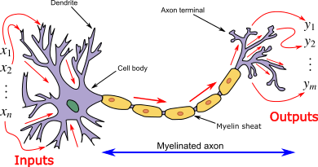
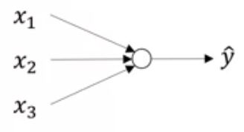
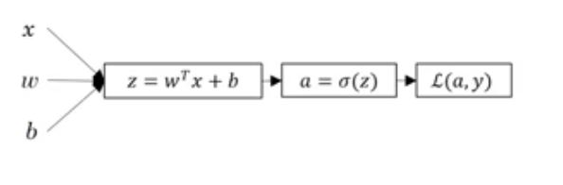
Introduction to Neural Networks
Artificial neural networks (ANNs), usually simply called neural networks (NNs), are computing systems vaguely inspired by the biological neural networks that constitute animal brains.

Slide 7
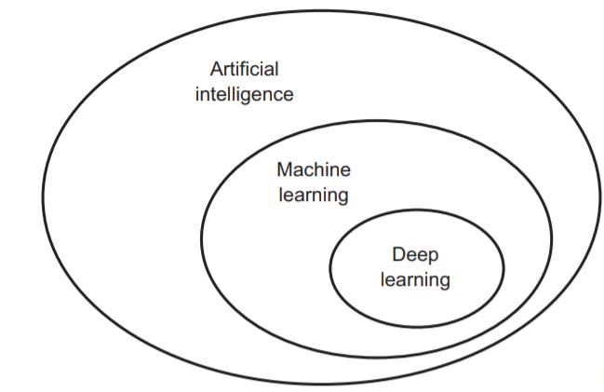
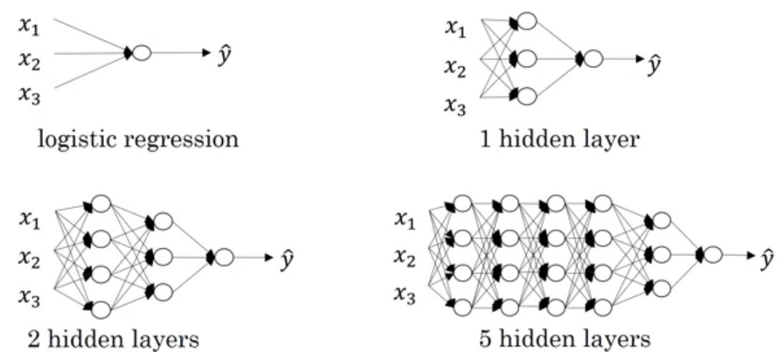
Introduction to Deep Learning
A machine learning model transforms its input data into meaningful outputs, a process that is learned from exposure to known examples of inputs and outputs. Therefore, the central problem in machine learning is to meaningfully transform data, in other words to learn useful representations of the input data at hand – representations that gets us closer to the expected output.
Deep learning is a specific subfield of machine learning. It is a new take on representations from data that puts emphasis on learning successive layers of increasingly meaningful representations. The deep In deep learning is reference to the depth of successive layers contributing to a model.

Slide 8
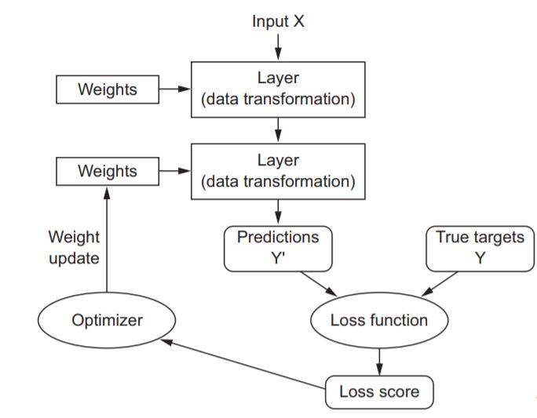
Deep Neural Network (DNN)
In deep learning, the layered representations are learned via neural networks. Deep neural networks do the input-to-target mapping via a deep sequence of simple data transformations and that these data transformations are learned by exposure to examples. Initially, the weights of the neural networks are assigned random values, so the network merely merely implements a series of random transformations. The output will be worse than ideal, and the loss score is accordingly high.

Slide 9
Designing Nanoplasmonic Structure
Training Data: Geometry, Metal Properties, The host’s permittivity, the optical response spectrum for both horizontal and vertical polarizations of the incoming field.
Test Data: Training data labels without Geometry.

Slide 10
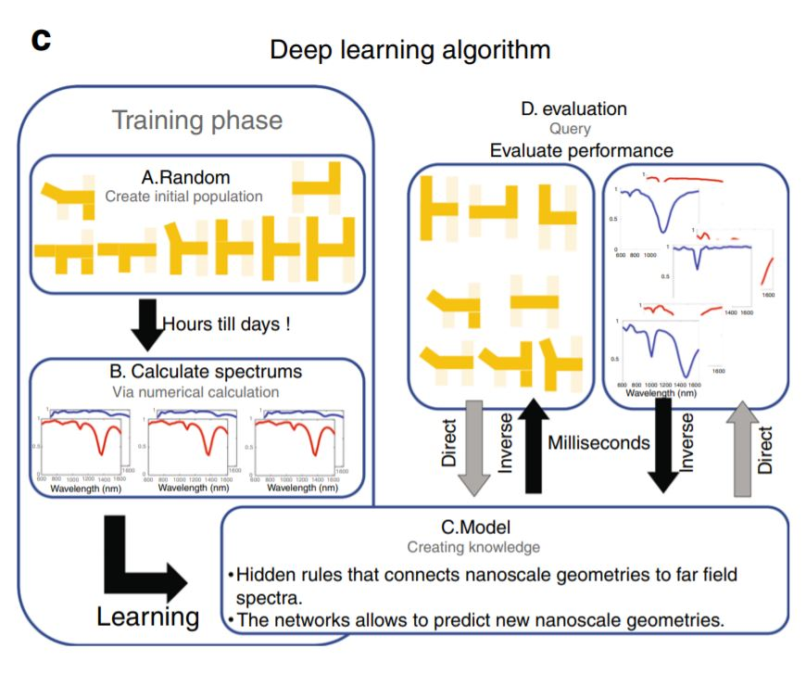

Slide 11
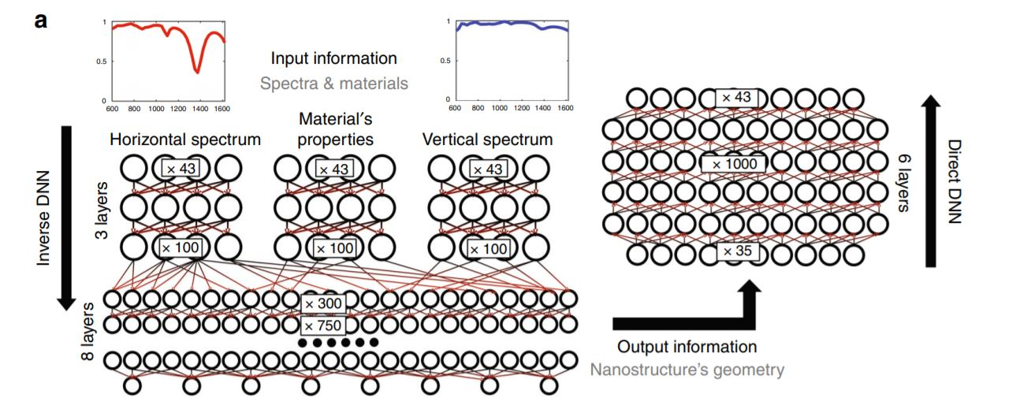

Slide 12
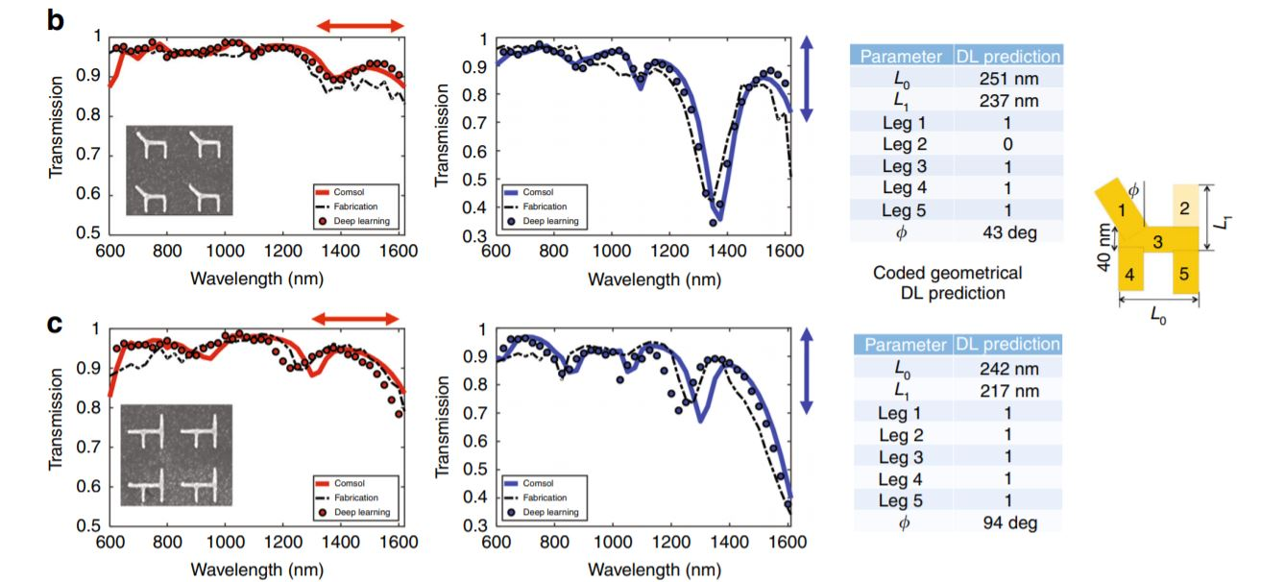

Slide 13
